Slide 1

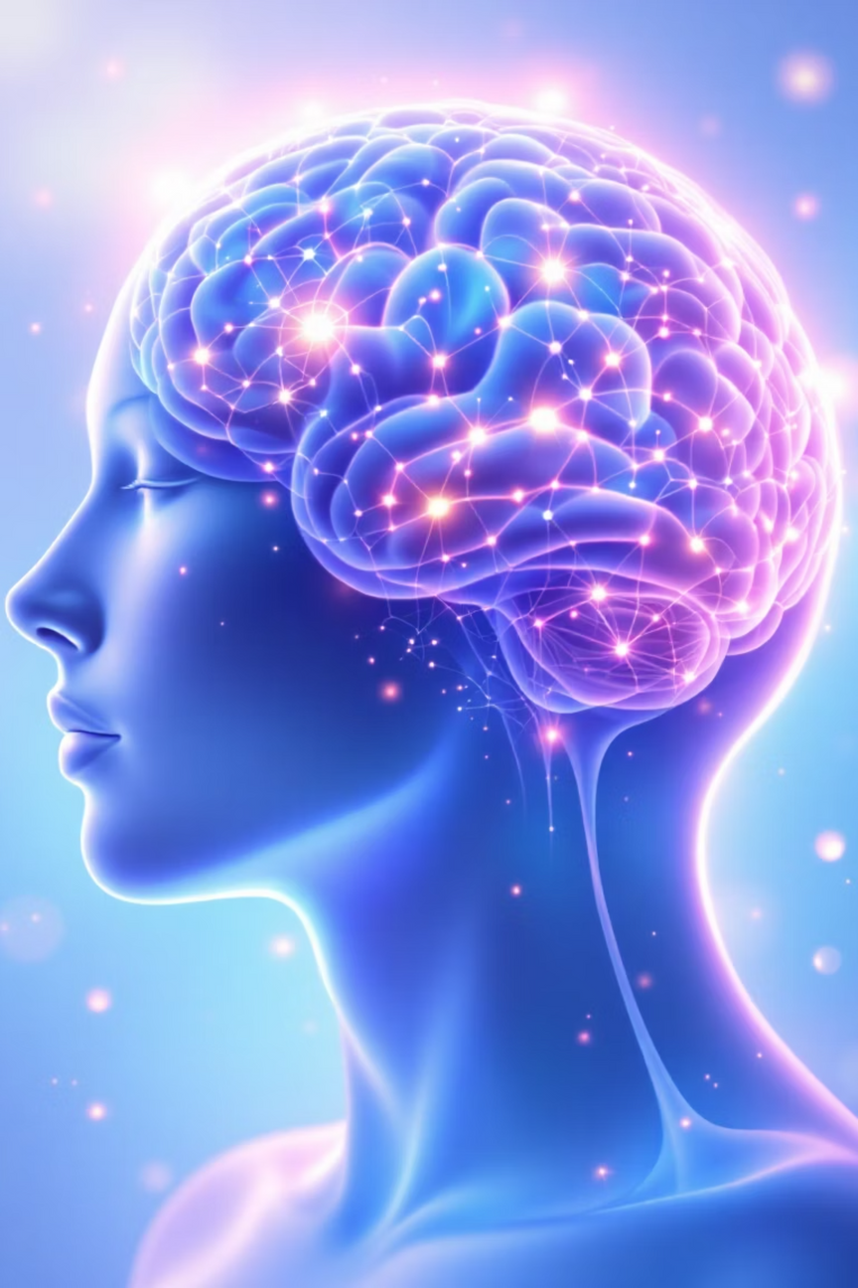
Brain MRI Tumor Detection
Medical Imaging Data Science Project
Name: Ravi Gohel | Branch: CSE - AI & ML |
University: Marwadi University | Year: 2025
Notes:
1

Slide 2
Abstract & Motivation
Project Overview
Clinical Motivation
The project builds and evaluates deep learning models for classifying brain MRI scans as "Tumor" or "No Tumor." Uses Kaggle dataset and explores CNN vs Transfer Learning (ResNet/EfficientNet).
Radiologists face large workloads; AI can accelerate tumor screening and support diagnosis.
Notes:
2

Slide 3
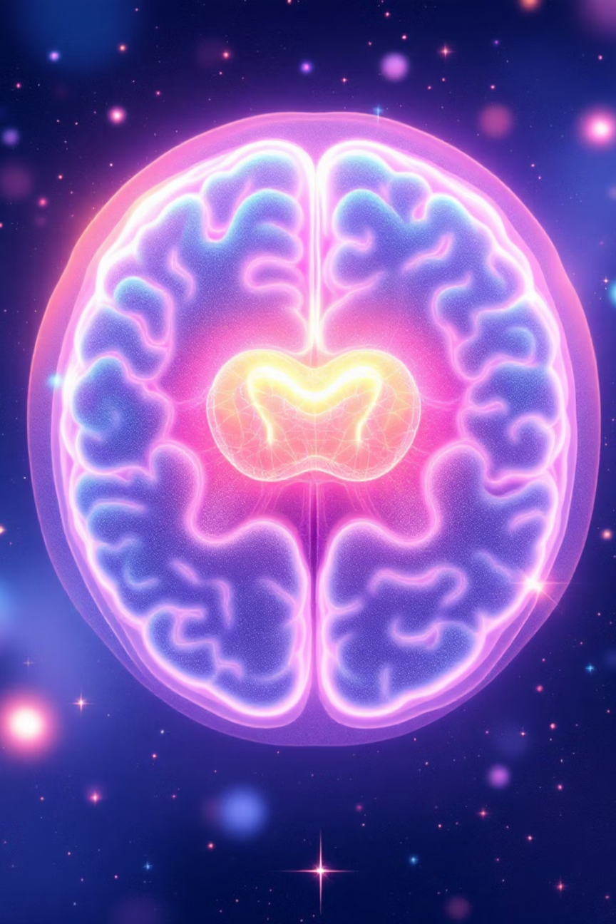
Dataset Overview & EDA
Dataset Details
Preprocessing & Analysis
Source: Kaggle "Brain MRI Images for Brain Tumor Detection"
Resized to 224×224 pixels
Normalized [0–1]
Checked pixel ranges
Total Images: 253
Found mild class imbalance (Tumor > No Tumor)
Tumor: 155 images
No Tumor: 98 images
Notes:
3

Slide 4
Data Preprocessing & Class Imbalance Handling
1
Data Augmentation
2
Weighted Loss Function
3
Train-Test Split
Applied rotation (±15°), flips, zoom (0.1), and shifts (0.1) to increase dataset diversity.
Applied weighted loss to balance minority class (No Tumor) and prevent model bias.
Ensured 80/20 train-test split with random shuffling to improve model generalization.
Notes:
4

Slide 5
Baseline Model (Logistic Regression)
Implemented Logistic Regression on flattened image features to serve as a baseline comparison for more complex models.
Validation Accuracy
This simple approach provided a reference point to evaluate whether more sophisticated deep learning architectures would deliver meaningful improvements.
~76%
Target: CNN should outperform baseline
Notes:
5

Slide 6
Custom CNN Model
1
2
Architecture
Training Configuration
3 Conv2D blocks (32–64–128 filters), MaxPooling, Dense(128), Dropout(0.5)
Optimizer: Adam | Loss: Binary Crossentropy | Early stopping to prevent overfitting
3
4
Validation Accuracy
Recall (Tumor)
~72%
87% — clinically important for detecting tumors
Notes:
6

Slide 7

Transfer Learning Model (EfficientNetB0)
Approach
Challenge & Outcome
Used pretrained EfficientNetB0 and fine-tuned top layers with learning rate of 1e-4.
Model overfitted due to small dataset. Predicted "Tumor" for all samples, resulting in 62% accuracy.
Key Lesson: Transfer learning models require larger datasets to avoid overfitting and achieve reliable performance on medical imaging tasks.
Notes:
7

Slide 8

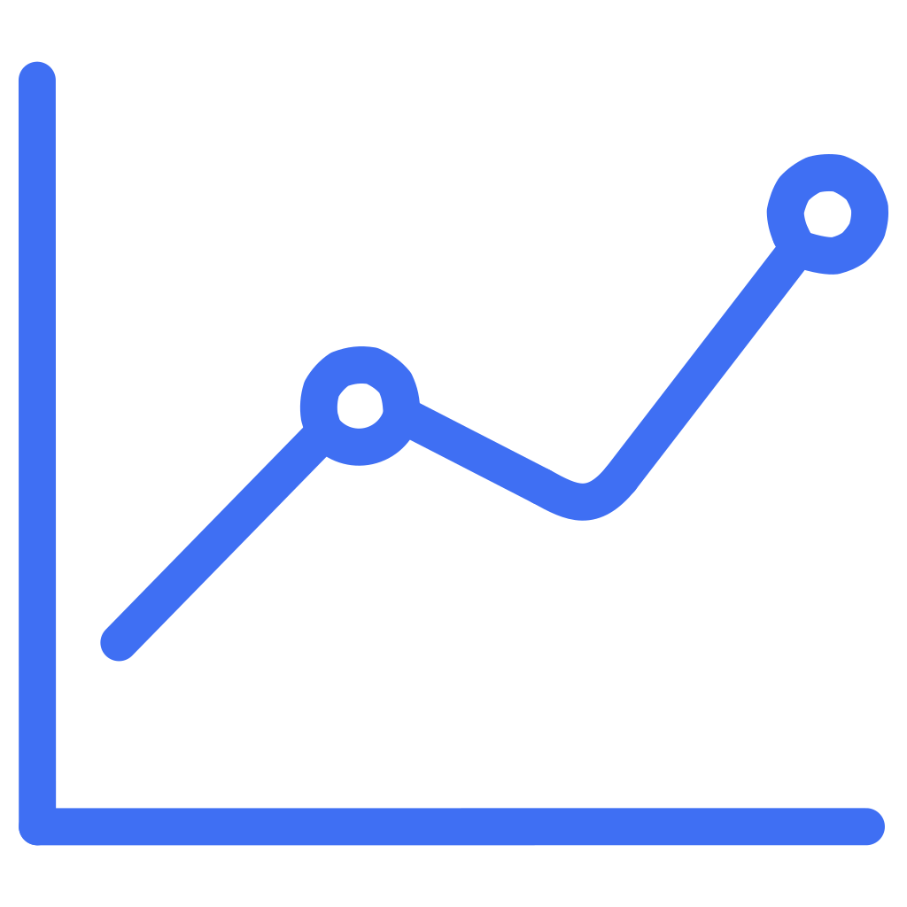


Results & Visualization
Compared CNN vs Logistic Regression vs EfficientNetB0. CNN achieved the best balance of recall and precision for clinical application.
ROC Curve
Confusion Matrix
Grad-CAM Visualization
Evaluated model discrimination ability across classification thresholds
Analysed true positives, false positives, true negatives, and false negatives
Highlighted tumor regions to provide explainability and clinical insight
Notes:
8

Slide 9
Discussion, Limitations & Future Work
Key Findings
Future Directions
CNN prioritised high recall — useful for medical triage to minimise missed diagnoses.
Add more MRI data to improve robustness
Use segmentation techniques (U-Net)
Current Limitations
Apply Explainable AI (Grad-CAM)
Build Streamlit diagnostic app for clinical deployment
Small dataset (253 images)
No cross-validation performed
Limited model diversity tested
Notes:
9

Slide 10
Conclusion & Q&A
Key Achievement
Clinical Impact
Path Forward
Brain MRI classification via CNN achieved 72% accuracy and 87% recall
Proved even small CNNs can assist in early tumor detection and support radiologist workflows
Integrating XAI and larger datasets can improve reliability and clinical adoption
Thank You — Questions?(DM direct ravi.gohel142996@marwadiuniversity.ac.in)
Notes:
10

